Slide 1
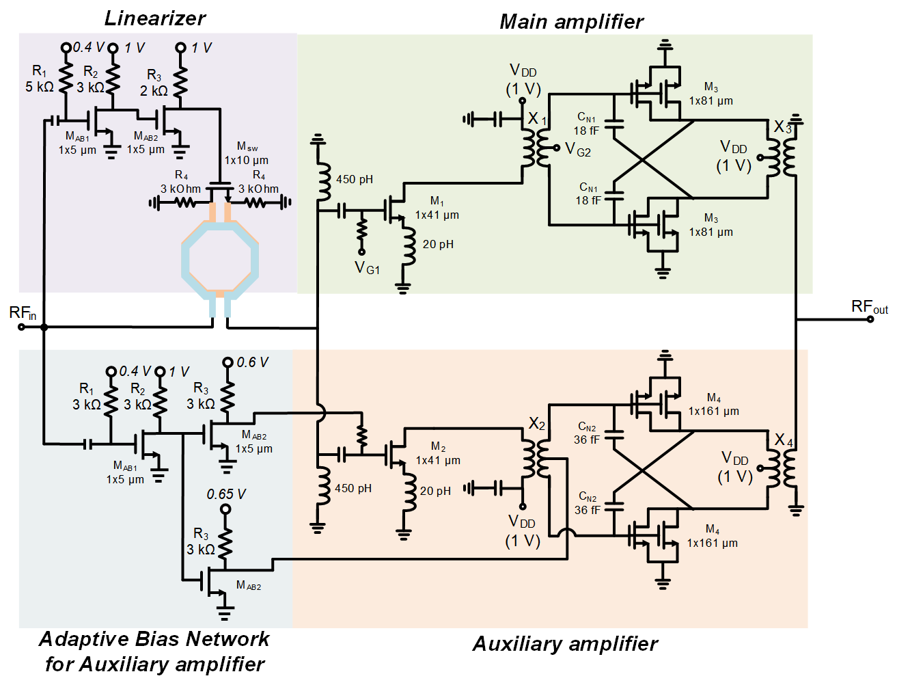
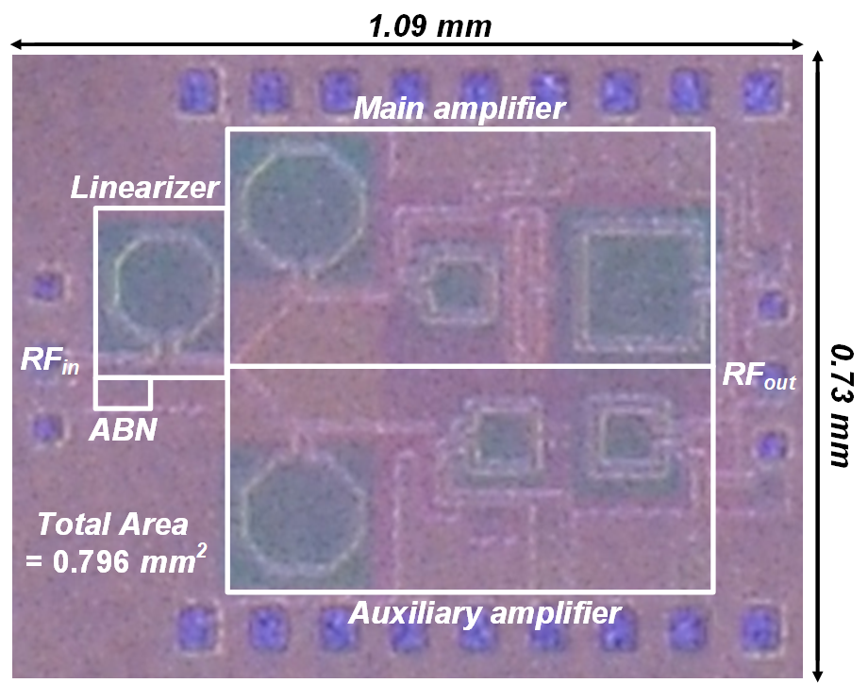
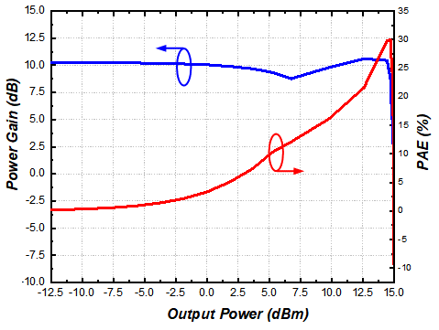
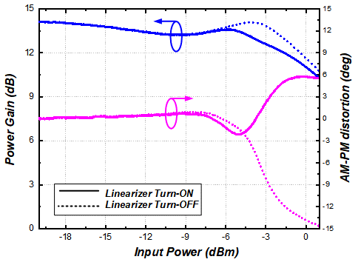
A 5G Communication CMOS Power Amplifier with
AM/PM Compensation Using Variable Inductor
Byungwook Kim, Yeheon Park and Sanggeun Jeon
School of Electrical Engineering, Korea University, Seoul 136-713, Korea
Introduction
Power amplifier (PA)
  Power amplifier (PA) is one of the most challenging RF blocks in CMOS technology
  Due to the demand of high data rate, the linearity of PA became more important.
  Moreover, since PA mainly operates back-off region, back-off efficiency is also important.
Design
By adopting capacitive neutralization, stability and gain are maximized
By adaptive bias network, auxiliary amplifier can be improved AM-AM linearity of total amplifier and back-off efficiency.
The AM-PM distortion caused by the operation of the amplifier is compensated for by a variable inductor in the input matching network
Experimental Results at 25 GHz
Performance | Value
P_{sat} | 15.1 dBm
PAE_{max} | 30%
PAE_{6-dB OBO} | 15.1%
OP1dB | 14.5 dBm
AM-PM (deg) < P1dB | < 2 deg
Gain | 10.1 dB
Conclusion
5G mm-Wave CMOS Power Amplifier is designed using 28-nm bulk CMOS technology.
PA has 15.1 dBm of saturated power, 30% of PAE_{max}, 15.1% of PAE_{6-dB OBO}, AM-PM within IP1dB < 2 deg.
The chip fabrication and EDA tool were supported by the IC Design Education Center(IDEC), Korea

